Slide 1
EE-2003
Computer Organization & Assembly Language
INSTRUCTOR
Engr. Aashir Mahboob
Lecturer, Department of Computer Science
FAST NUCES (Karachi)
Aashir.mahboob@nu.edu.pk

Slide 2
Chapter 9: Strings & Arrays

Slide 3
Strings & Arrays
String Primitive Instructions
Selected String Procedures
Two-Dimensional Arrays
Searching and Sorting Integer Arrays

Slide 4
String Primitive Instructions

Slide 5
String Primitive Instructions
MOVSB, MOVSW, and MOVSD
CMPSB, CMPSW, and CMPSD
SCASB, SCASW, and SCASD
STOSB, STOSW, and STOSD
LODSB, LODSW, and LODSD

Slide 6
MOVSB, MOVSW, & MOVSD
The MOVSB, MOVSW, and MOVSD instructions copy data from the memory location pointed to by ESI to the memory location pointed to by EDI.
Example:
  .data
  source DWORD 0FFFFFFFFh
  target DWORD ?
  .code
  mov esi, OFFSET source
  mov edi, OFFSET target
  movsd

Slide 7
MOVSB, MOVSW, & MOVSD
ESI and EDI are automatically incremented or decremented:
  MOVSB increments/decrements by 1
  MOVSW increments/decrements by 2
  MOVSD increments/decrements by 4

Slide 8
Direction Flag
The Direction flag controls the incrementing or decrementing of ESI and EDI.
  DF = clear (0): increment ESI and EDI
  DF = set (1): decrement ESI and EDI
The Direction flag can be explicitly changed using the CLD and STD instructions:
  CLD ; clear Direction flag
  STD ; set Direction flag

Slide 9
Using a Repeat Prefix
By itself, a string primitive instruction processes only a single memory value or pair of values.
REP (a repeat prefix) can be inserted just before MOVSB, MOVSW, or MOVSD
ECX controls the number of repetitions
Example: Copy 20 doublewords from source to target
  .data
  source DWORD 20 DUP(?)
  target DWORD 20 DUP(?)
  .code
  cld ; direction = forward
  mov ecx,LENGTHOF source ; set REP counter
  mov esi,OFFSET source
  mov edi,OFFSET target
  rep movsd

Slide 10
Example
Use MOVSD to delete the first element of the following doubleword array. All subsequent array values must be moved one position forward toward the beginning of the array: array DWORD 1,1,2,3,4,5,6,7,8,9,10
Solution:
  .data
  array DWORD 1,1,2,3,4,5,6,7,8,9,10
  .code
  cld
  mov ecx,(LENGTHOF array) - 1
  mov esi,OFFSET array+4
  mov edi,OFFSET array
  rep movsd

Slide 11
CMPSB, CMPSW, & CMPSD
The CMPSB, CMPSW, and CMPSD instructions each compare a memory operand pointed to by ESI to a memory operand pointed to by EDI
  CMPSB compares bytes
  CMPSW compares words
  CMPSD compares doublewords
Repeat prefix often used
  REPE (REPZ)
  REPNE (REPNZ)

Slide 12
Comparing a Pair of Doublewords
If source > target, the code jumps to label L1; otherwise, it jumps to label L2
Solution:
  .data
  source DWORD 1234h
  target DWORD 5678h
  .code
  mov esi, OFFSET source
  mov edi, OFFSET target
  cmpsd ; compare doublewords
  ja L1 ; jump if source > target
  jmp L2 ; jump if source <= target

Slide 13
Comparing a Pair of Doublewords
Modify the program in the previous slide by declaring both source and target as WORD variables. Make any other necessary changes.
Solution:

Slide 14
Comparing a Pair of Doublewords
Use a REPE (repeat while equal) prefix to compare corresponding elements of two arrays
Solution:
  .data
  COUNT = 20
  source DWORD COUNT DUP(?)
  target DWORD COUNT DUP(?)
  .code
  mov ecx, COUNT ; repetition count
  mov esi, OFFSET source
  mov edi, OFFSET target
  cld ; direction = forward
  repe cmpsd ; repeat while equal

Slide 15
Example: Comparing Two Strings
This program compares two strings (source and destination). It displays a message indicating whether the lexical value of the source string is less than the destination string.
Solution:
  .data
  source BYTE "MARTIN "
  dest BYTE "MARTINEZ"
  str1 BYTE "Source is smaller",0dh,0ah,0
  str2 BYTE "Source is not smaller",0dh,0ah,0

Slide 16
Example: Comparing Two Strings
  .code
  main PROC
  cld ; direction = forward
  mov esi, OFFSET source
  mov edi, OFFSET dest
  mov ecx, LENGTHOF source
  repe cmpsb
  jb source_smaller
  mov edx,OFFSET str2 ; "source is not smaller"
  jmp done
  source_smaller:
  mov edx,OFFSET str1 ; "source is smaller"
  done:
  call WriteString
  exit
  main ENDP
  END main

Slide 17
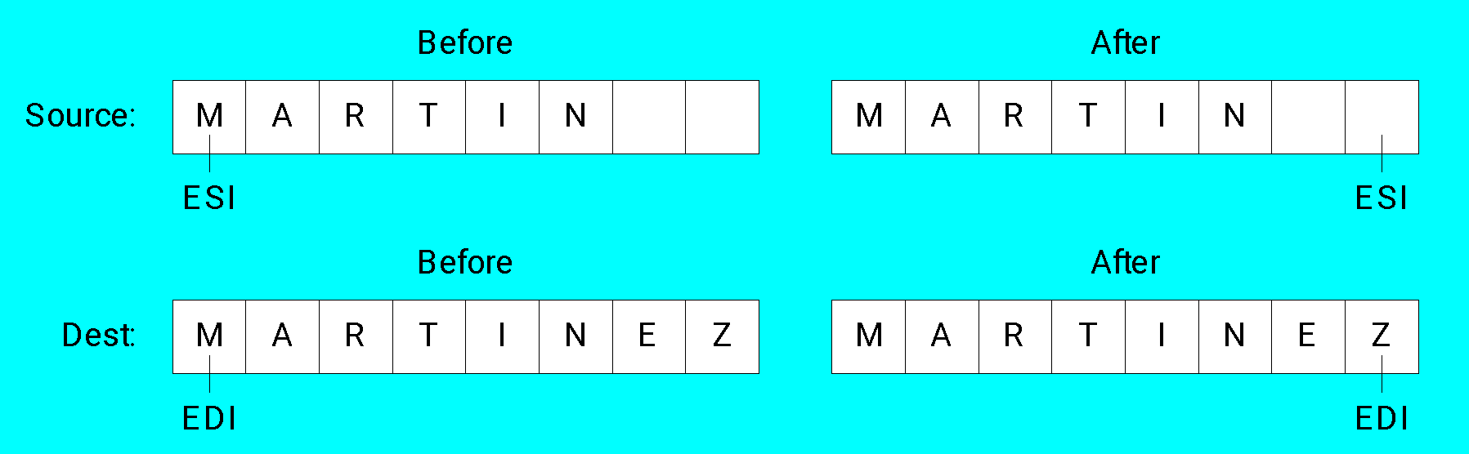
Example: Comparing Two Strings
The following diagram shows the final values of ESI and EDI after comparing the strings:

Slide 18
SCASB, SCASW, & SCASD
The SCASB, SCASW, and SCASD instructions compare a value in AL/AX/EAX to a byte, word, or doubleword, respectively, addressed by EDI
Useful types of searches:
  Search for a specific element in a long string or array
  Search for the first element that does not match a given value

Slide 19
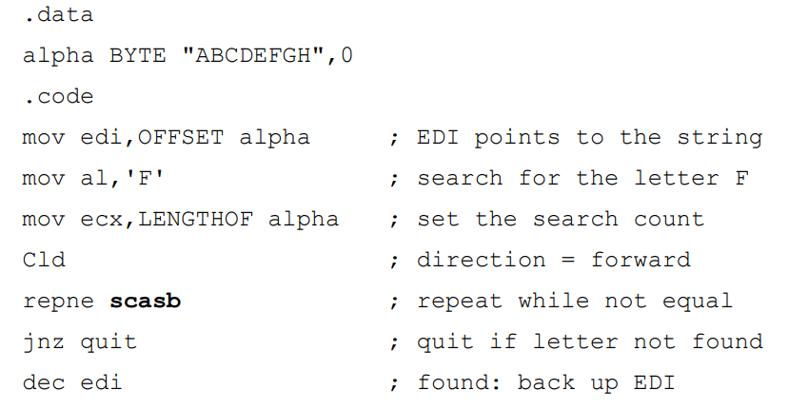
SCASB, SCASW, & SCASD
Search for the letter 'F' in a string named alpha:
Solution:

Slide 20
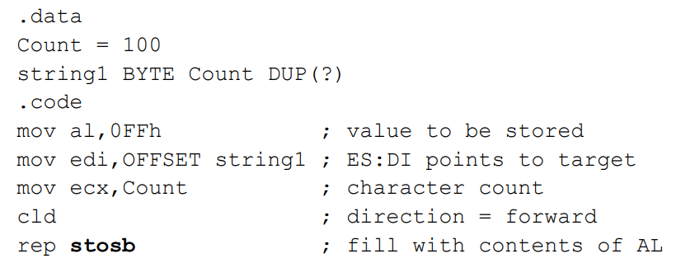
STOSB, STOSW, & STOSD
The STOSB, STOSW, and STOSD instructions store the contents of AL/AX/EAX, respectively, in memory at the offset pointed to by EDI
When used with the REP prefix, these instructions are useful for filling all elements of a string or array with a single value
Example: fill an array with 0FFh

Slide 21
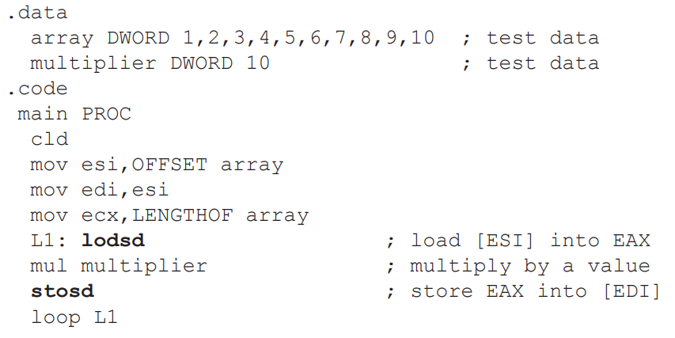
LODSB, LODSW & LODSD
LODSB, LODSW, and LODSD load a byte or word from memory at ESI into AL/AX/EAX, respectively.
•The REP prefix is rarely used with LODS because each new value loaded into the accumulator overwrites its previous contents.
• Instead, LODS is used to load a single value.
Example:

Slide 22
Exercixe
Write a program that converts each unpacked binary-coded decimal byte belonging to an array into an ASCII decimal byte and copies it to a new array.
  .data
  array BYTE 1,2,3,4,5,6,7,8,9
  dest BYTE (LENGTHOF array) DUP(?)
Solution:
  .code
  mov esi,OFFSET array
  mov edi,OFFSET dest
  mov ecx,LENGTHOF array
  cld ; direction = up
  L1: lodsb ; load into AL
  or al,30h ; convert to ASCII
  stosb ; store into memory
  loop L1

Slide 23
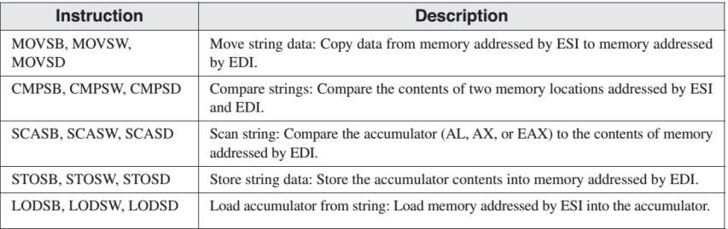
•Although they are called string primitives, they are not limited to character arrays.
•Each instruction implicitly uses ESI, EDI, or both registers to address memory.
•String primitives execute efficiently because they automatically repeat and increment array indexes.

Slide 24
Selected String Procedures

Slide 25
Selected String Procedures
The following string procedures may be found in the Irvine32 and Irvine16 libraries:
  Str_compare Procedure
  Str_length Procedure
  Str_copy Procedure
  Str_trim Procedure
  Str_ucase Procedure

Slide 26
PROTO DIRECTIVE
•Creates a procedure prototype
label PROTO paramList
•Every procedure called by the INVOKE directive must have a prototype.
•A complete procedure definition can also serve as its own prototype.
•Standard configuration: PROTO appears at top of the program listing, INVOKE appears in the code segment, and the procedure implementation occurs later in the program.

Slide 27
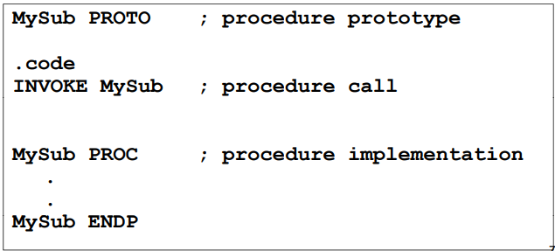
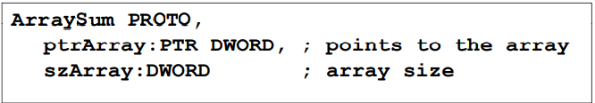
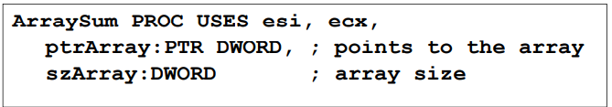
EXAMPLE
• Prototype for the ArraySum procedure, showing its parameter list:

Slide 28
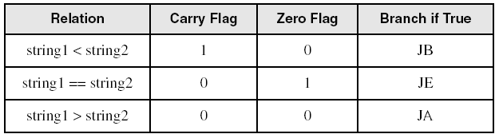
Str_compare Procedure
Compares string1 to string2, setting the Carry and Zero flags accordingly
PROTOTYPE (PROTO):
  Str_compare PROTO,
  string1:PTR BYTE, ; pointer to string
  string2:PTR BYTE ; pointer to string

Slide 29
Str_compare Procedure Source Code
  Str_compare PROC USES eax edx esi edi,
  string1:PTR BYTE, string2:PTR BYTE
  mov esi,string1
  mov edi,string2
  L1: mov al,[esi]
  mov dl,[edi]
  cmp al,0 ; end of string1?
  jne L2 ; no
  cmp dl,0 ; yes: end of string2?
  jne L2 ; no
  jmp L3 ; yes, exit with ZF = 1
  L2: inc esi ; point to next
  inc edi
  cmp al,dl ; chars equal?
  je L1 ; yes: continue loop
  L3: ret
  Str_compare ENDP

Slide 30
Str_length Procedure
Calculates the length of a null-terminated string and returns the length in the EAX register
PROTOTYPE (PROTO):
  Str_length PROTO,
  pString:PTR BYTE ; pointer to string
Example:
  .data
  myString BYTE "abcdefg",0
  .code
  INVOKE Str_length, ADDR myString ; EAX = 7

Slide 31
Str_length Procedure Source Code
  Str_length PROC USES edi,
  pString:PTR BYTE ; pointer to string
  mov edi, pString
  mov eax,0 ; character count
  L1:
  cmp byte ptr [edi],0 ; end of string?
  je L2 ; yes: quit
  inc edi ; no: point to next
  inc eax ; add 1 to count
  jmp L1
  L2: ret
  Str_length ENDP

Slide 32
Str_copy Procedure
Copies a null-terminated string from a source location to a target location
PROTOTYPE (PROTO):
  Str_copy PROTO,
  source:PTR BYTE, ; pointer to string
  target:PTR BYTE ; pointer to string
Example:
  .data
  source BYTE "hello",0
  target BYTE SIZEOF source DUP (?)
  .code
  INVOKE Str_copy, ADDR source, ADDR target

Slide 33
Str_copy Procedure Source Code
  Str_copy PROC USES eax ecx esi edi,
  source:PTR BYTE, ; source string
  target:PTR BYTE ; target string
  INVOKE Str_length,source ; EAX = length source
  mov ecx,eax ; REP count
  inc ecx ; add 1 for null byte
  mov esi,source
  mov edi,target
  cld ; direction = up
  rep movsb ; copy the string
  ret
  Str_copy ENDP

Slide 34
Str_trim Procedure
The Str_trim procedure removes all occurrences of a selected trailing character from a null-terminated string
PROTOTYPE (PROTO):
  Str_trim PROTO,
  pString:PTR BYTE, ; points to string
  char:BYTE ; char to remove
Example:
  .data
  myString BYTE "Hello###",0
  .code
  INVOKE Str_trim, ADDR myString, '#'
  myString = "Hello"

Slide 35
Str_trim Procedure
Str_trim checks a number of possible cases (shown here with # as the trailing character:
The string is empty
The string contains other characters followed by one or more trailing characters, as in "Hello##"
The string contains only one character, the trailing character, as in "#"
The string contains no trailing character, as in "Hello" or "H"
The string contains one or more trailing characters followed by one or more nontrailing characters, as in "#H" or "###Hello"

Slide 36
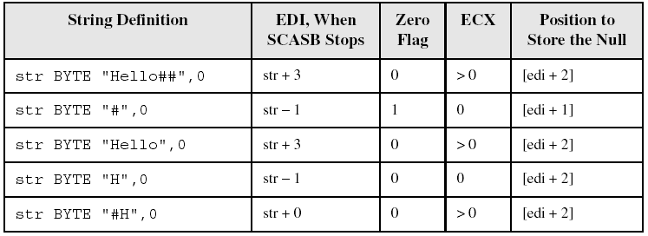
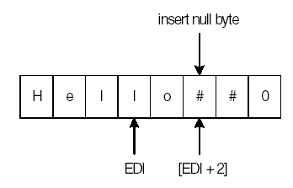
Str_trim Procedure
Using the first definition in the table, position of EDI when SCASB stops:

Slide 37
Str_trim Procedure Source Code
  Str_trim PROC USES eax ecx edi,
  pString:PTR BYTE, ; points to string
  char: BYTE ; character to remove
  mov edi,pString ; prepare to call Str_length
  INVOKE Str_length,edi ; returns the length in EAX
  cmp eax,0 ; is the length equal to zero?
  je L3 ; yes: exit now
  mov ecx,eax ; no: ECX = string length
  dec eax
  add edi,eax ; point to last character
  L1: mov al,[edi] ; get a character
  cmp al,char ; is it the delimiter?
  jne L2 ; no: insert null byte
  dec edi ; yes: keep backing up
  loop L1 ; until beginning reached
  L2: mov BYTE PTR [edi+1],0 ; insert a null byte
  L3: ret
  Stmr_trim ENDP

Slide 38
Str_ucase Procedure
The Str_ucase procedure converts a string to all uppercase characters. It returns no value.
PROTOTYPE (PROTO):
  Str_ucase PROTO,
  pString:PTR BYTE ; pointer to string
Example:
  .data
  myString BYTE "Hello",0
  .code
  INVOKE Str_ucase, ADDR myString

Slide 39
Str_ucase Procedure Source Code
  Str_ucase PROC USES eax esi,
  pString:PTR BYTE
  mov esi,pString
  L1: mov al,[esi] ; get char
  cmp al,0 ; end of string?
  je L3 ; yes: quit
  cmp al,'a’ ; below "a"?
  jb L2
  cmp al,'z’ ; above "z"?
  ja L2
  and BYTE PTR [esi],11011111b ; convert the char
  L2: inc esi ; next char
  jmp L1
  L3: ret
  Str_ucase ENDP

Slide 40
Two-Dimensional Arrays

Slide 41
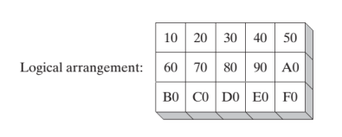


•The two methods of arranging the rows and columns in memory: row-major order and column-major order.
•If you implement a two-dimensional array in assembly language, you can choose either ordering method.

Slide 42
THE TWO OPERAND TYPES
Base-Index Operands
Base-Index Displacement Operands

Slide 43
Base-Index Operand
A base-index operand adds the values of two registers (called base and index), producing an effective address
  Any two 32-bit general-purpose registers may be used (Note: esp is not used for general purpose)
[base + index]

Slide 44
Base-Index-Displacement Operand
A base-index-displacement operand combines a displacement, a base register, an index register, and an optional scale factor to produce an effective address.
Displacement can be the name of a variable or a constant expression.
Common Format:
  [base + index + displacement]
  displacement[base + index]

Slide 45
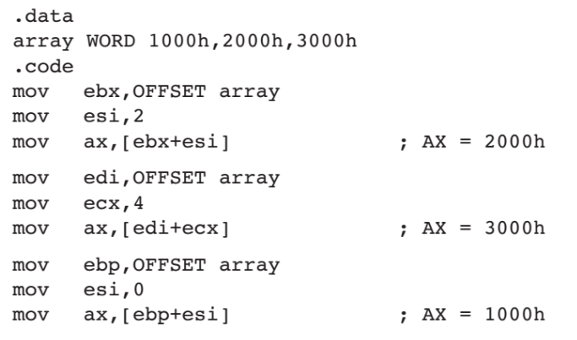
BASE-INDEX OPERANDS

Slide 46
Two-Dimensional Array Example
Imagine a table with three rows and five columns. The data can be arranged in any format on the page:
  table BYTE 10h, 20h, 30h, 40h, 50h
  BYTE 60h, 70h, 80h, 90h, 0A0h
  BYTE 0B0h, 0C0h, 0D0h, 0E0h, 0F0h
  NumCols = 5
Alternative format:
  table BYTE 10h,20h,30h,40h,50h,60h,70h,80h,90h,0A0h,0B0h,0C0h,0D0h,0E0h,0F0h
  NumCols = 5

Slide 47
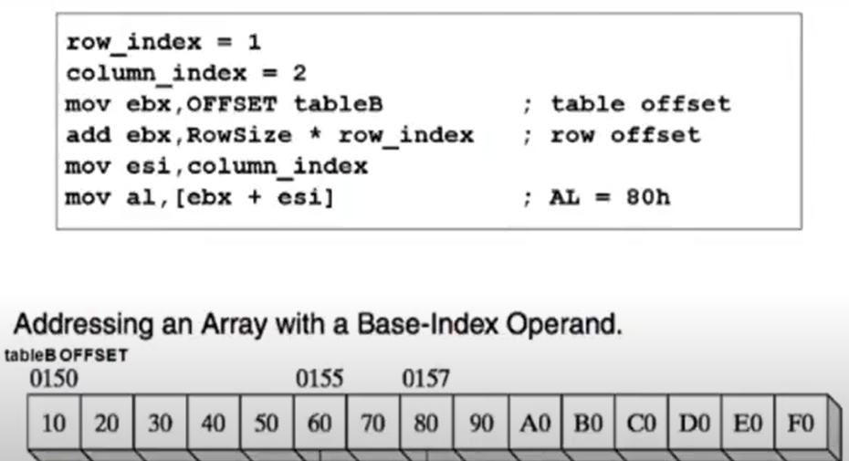
Two-Dimensional Array Example
The following code loads the table element stored in row 1, column 2:

Slide 48
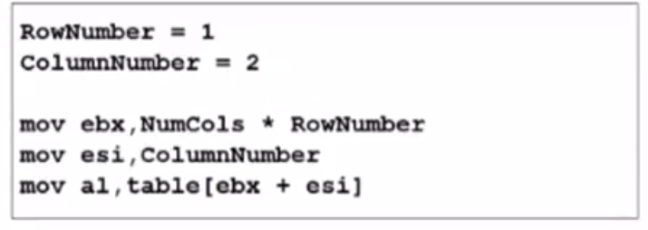
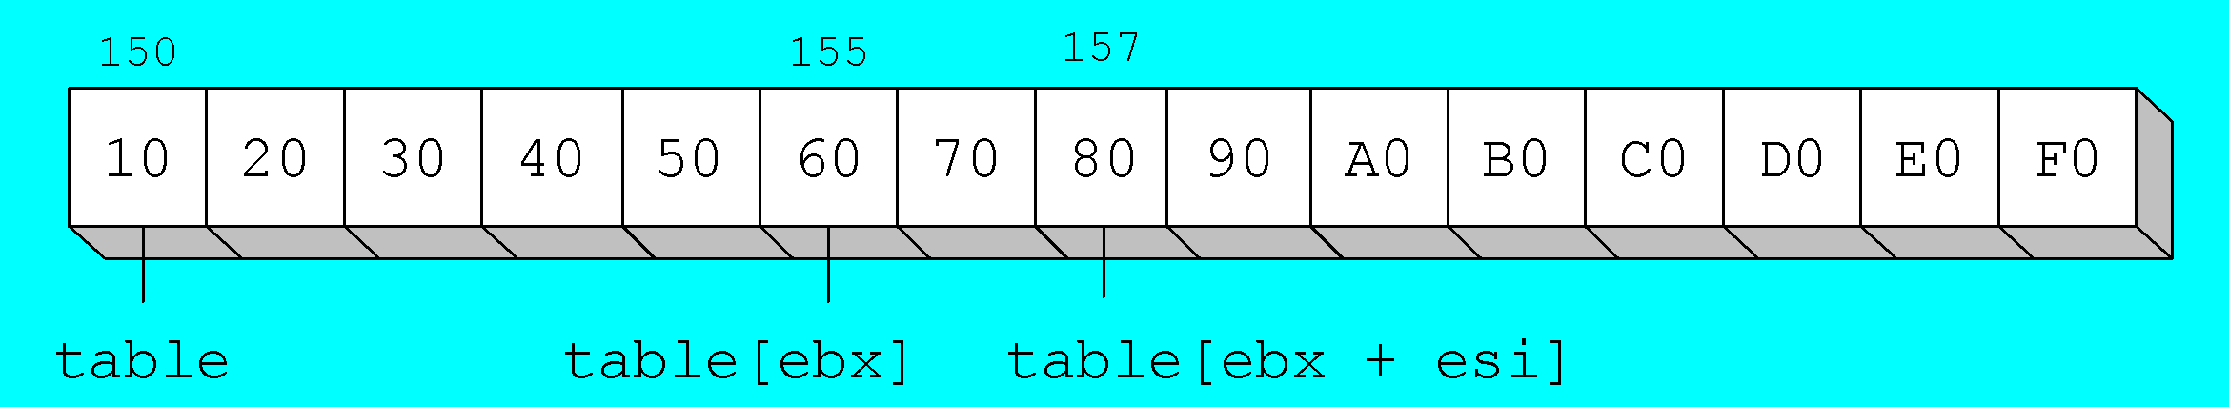
Two-Dimensional Array Example
The following code loads the table element stored in row 1, column 2:

